Slide 1
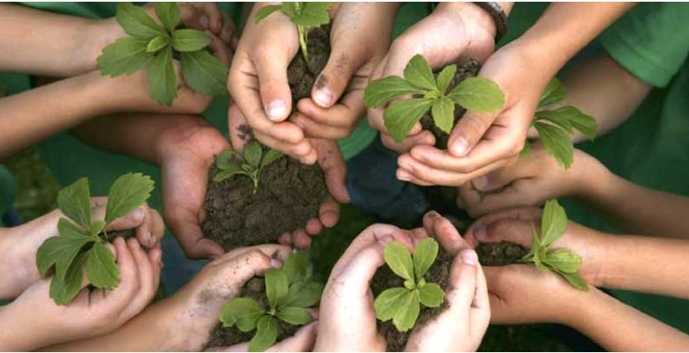
Let’s build together
Ernesto Cavassa sj
Belén Romá

Slide 2
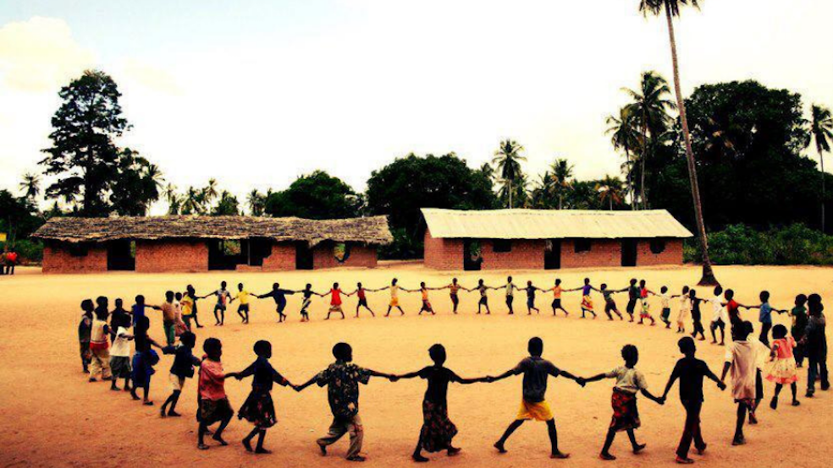
THE WITNESS OF UBUNTU AFRICA

Slide 3
Global Compact on Education
INSTRUMENTUM LABORIS
Let us return to
IL

Slide 4
VIDEO MESSAGE FROM POPE FRANCIS TO THE MEETING ON THE GLOBAL COMPACT ON EDUCATION (15/10/2020) https://www.youtube.com/watch?v=Tdau9DFtMn8

Slide 5
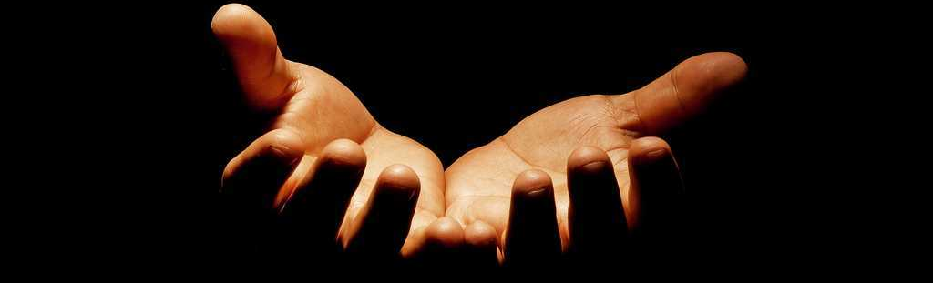
1. OPENNESS TO THE OTHER AS A BASIS
The other is not a threat but a companion on the journey
With whom I establish a pact, a covenant; the Biblical value of the term
Each contribution is indispensable
To educate is never easy, even less so now
The context of emergency education.

Slide 6
Foundational experience; anthropological data
The moral and religious background; it includes all of us
The throwaway culture destroys fraternity
Faced with it: the « planetary village of education » reminds us of the original brotherhood
« Indeed we have been created not only to live « with others » but also to live « at the service of others », in salvific and enriching reciprocity.
2.THE ORIGINAL BROTHERHOOD (COMMUNITY)

Slide 7
The transforming experience of the Spiritual Exercises of Saint Ignatius of Loyola
SOME CONSIDERATIONS ON IGNATIAN SPIRITUALITY
The Principle and Foundation
Ignatius the Pilgrim

Slide 8
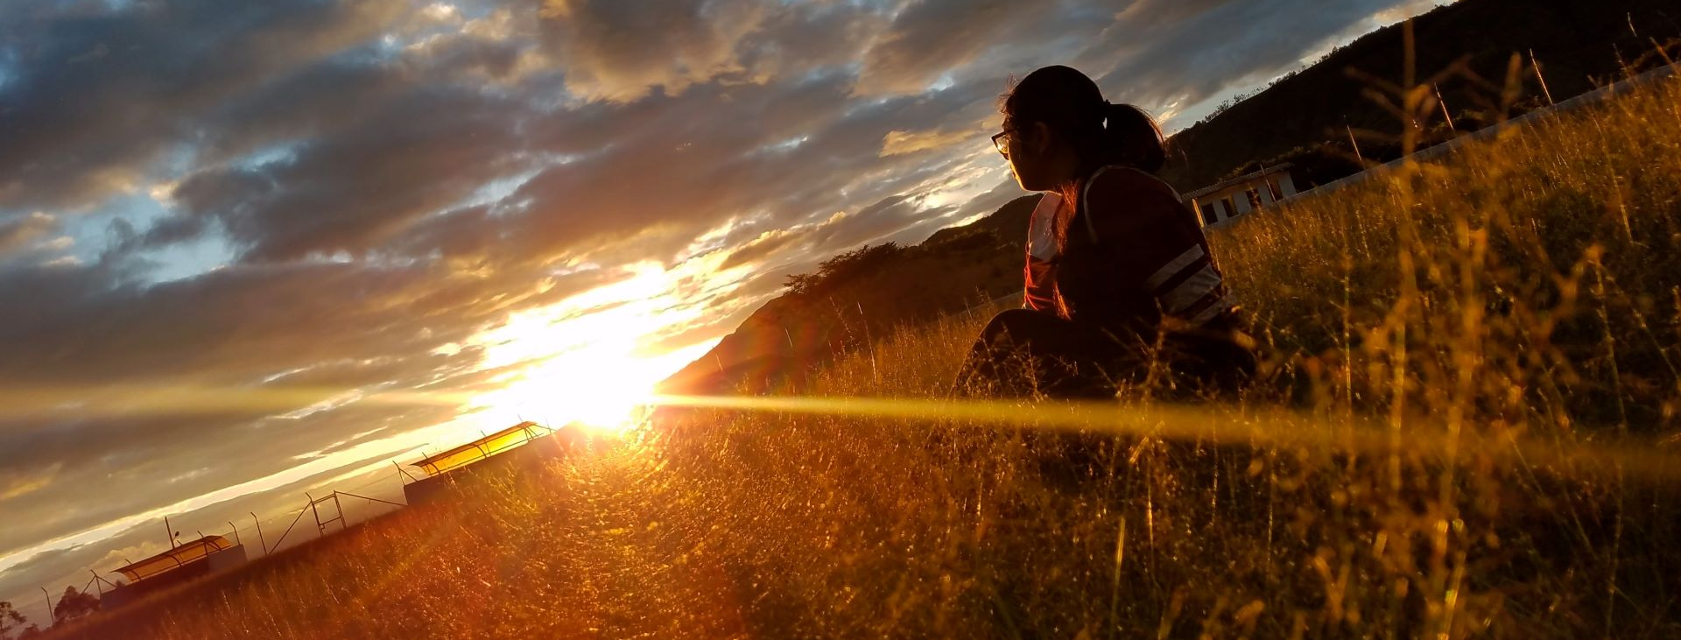
1.THE PRINCIPLE AND FOUNDATION
In the Spiritual Exercises: the experience of pilgrimage and the search for the will of God is opened for us
In basic Ignatian anthropological terms: the person is created for… God, therefore all other things are oriented to this end
God is the horizon. Created things are a means of reaching Him
The permanent Election is based on the « magis »

Slide 9
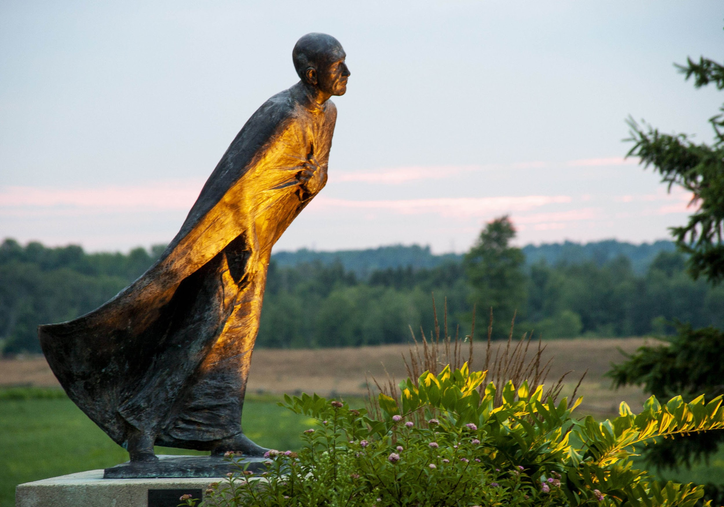
2. Ignatius the pilgrim
In his conversation until his death he seeks the will of God (his horizon)
The Spiritual Exercises are an expression of this search: revealing a spirituality of discernment for the making of decisions.
Francis invites us to unite ourselves as pilgrims, to bring our contribution to the GCE.

Slide 10
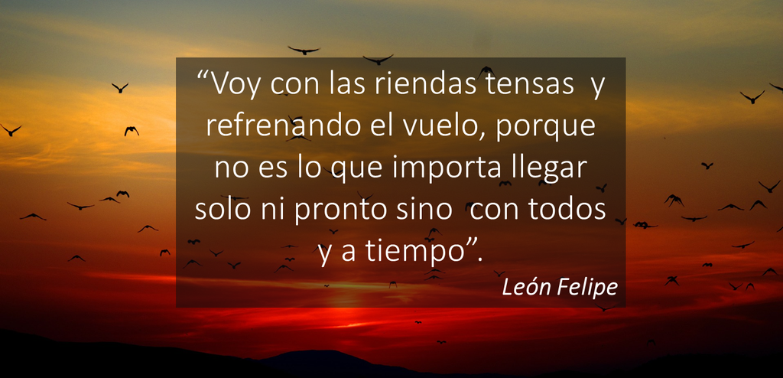
“I am going with taut reins while slowing my device. it is not important to arrive alone or before time, but to arrive with everybody and on time.”
Leon Felipe

Slide 11
PERSONAL WORK QUESTIONS
How does today’s material find echoes in me? Personal echoes (one or two words and an image)
What in the GCE challenges me in the JM mission where I am ? After today’s work, where does the pact inspire me to renew TOGETHER the JM mission in which I participate?

